Slide 1
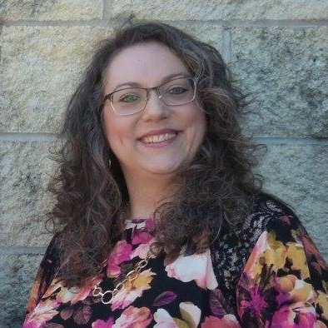
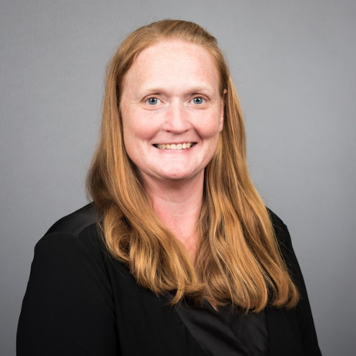
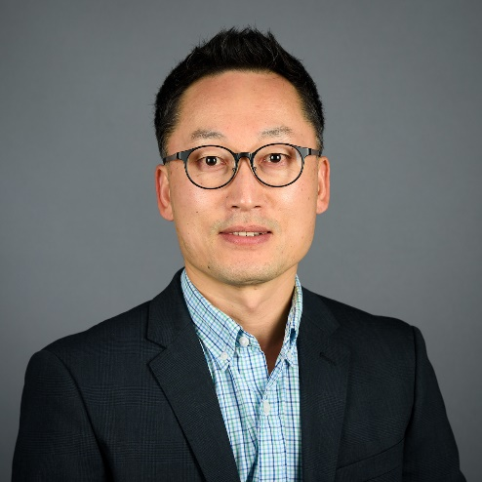
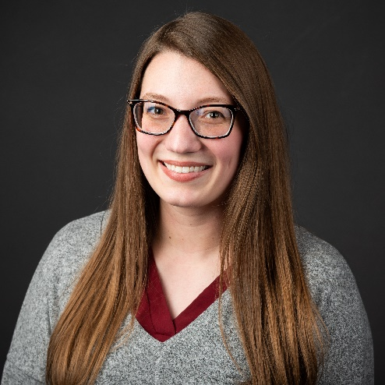
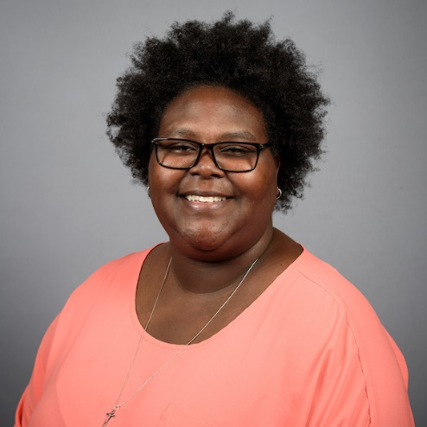
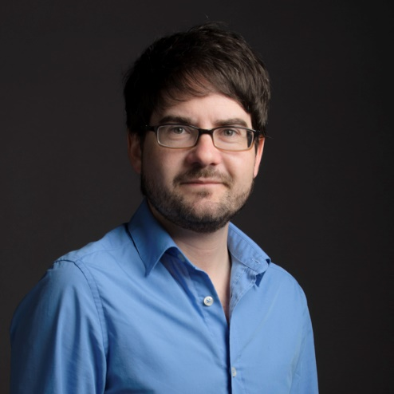
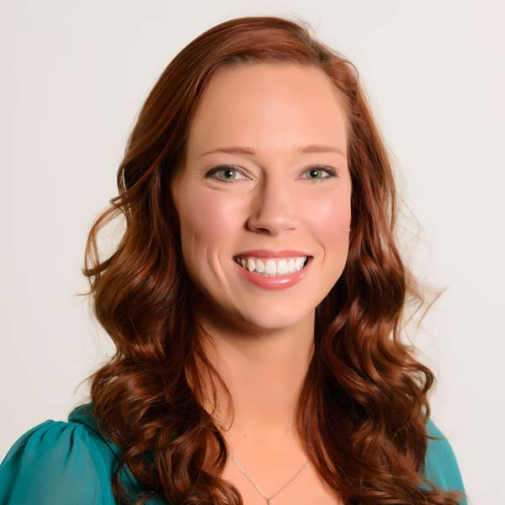
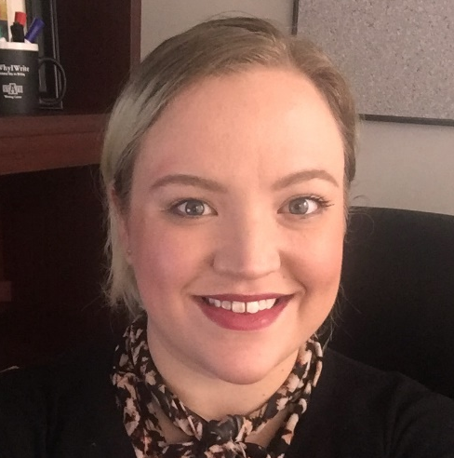
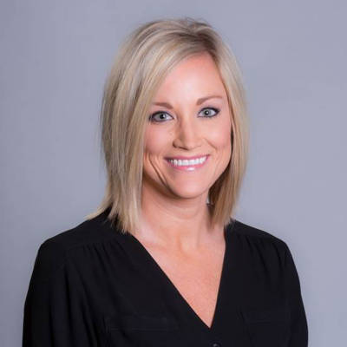
Learning Services
Notes:
I came in to tutoring a little over a year ago, and when I started digging in, I found out that there were nine tutoring centers on campus. NINE! Some new, some old, and some specific to sub-sets of our overall student population, but none the less, nine centers.

Slide 2
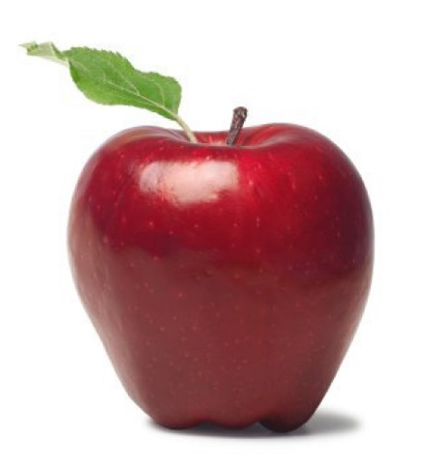
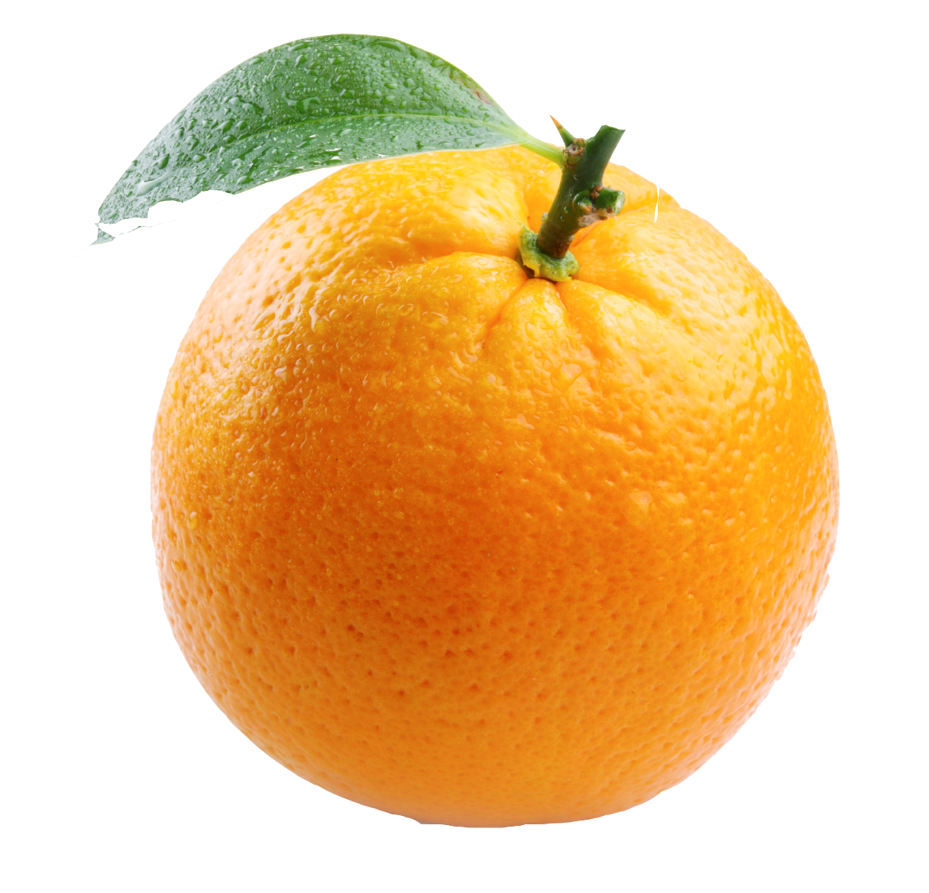
Person Power
17:1
FTE Student to Faculty Ratio
Spring, 2019
78:1
F2F Student to Tutor Ratio
Spring, 2019
Notes:
To give you an idea of how much person-power we represent on campus, this is an apples to oranges comparison of our current Full-time-equivalent student to faculty ration, and our face-to-face student to tutor ratio. The first was reported on the astate website by recruitment, and the second was reported by me, here.
We have 116 student tutors on campus.

Slide 3
Student Support Services
Math Learning Commons
Engineering Homework Helpers
STEM & GenEd Tutoring
World Languages Tutoring
Learning Services
SMART Center
Academic Success Center
Comm. Center
Writing Center
Notes:
After doing all of that digging, I found at that I represented the only tutoring center that was formally assessing as a co-curricular program. With most other centers reporting to their departments, and primarily on administrative outcomes (i.e. students in the center).

Slide 4

Summer Workshopping
Notes:
The purpose of this assessment investigation will be to familiarize all tutoring centers with co-curricular assessment, and workshop to create center-specific plans that may additionally include a learning outcome that stretches across all of the centers.

Slide 5

Learning Services
Notes:
When this investigation is successful, centers will function more efficiently. They will be empowered to leverage assessment outcomes for future resource development and retention.
And we will ultimately have the opportunity to report cohesively as A-State Learning Services to give our campus community a better understanding of who we are and the impact we’re making on campus.

